Slide 1
Developing Application For Predicting RBC,WBC And Platelets Count With Microscopic Blood Image and Yolo Model
Guide – Krishna Kumar Singh
N190685 - Kamatham Narasimha Reddy
N191122 – Kadi Shanmukha Sai Vignesh
N190662 – Dasari Aswini
N190729 – Yadlapalli Supriya
N190851 – Chintada Tharun

Slide 2
Table of Contents
Abstract
Objective
Introduction
- Blood Cells
YOLO
- How Yolo Works
- How we are using it
Dataset
File Structure
Python Implementation
Accuracy
Streamlit Application
Challenges and Solutions
Future Work
Result
References

Slide 3
Abstract
This study develops a method for automated blood cell counting using the YOLO model.
We train the model with a dataset of microscopic blood images. The model is then tested to output counts of red blood cells (RBCs), white blood cells (WBCs), and platelets.
This approach aims to provide a fast, accurate tool for hematological analysis.
Our results show the YOLO model effectively identifies and quantifies blood cells in microscopic images.
We effectively identify and quantify blood cells in microscopic images using the YOLO model.

Slide 4
Objective
Diagnosing medical conditions and keeping track of existing ones , evaluating overall health, and detecting blood disorders.
It will reduce the cost of CBC (Complete Blood Count) and minimize blood wastage. It delivers reliable service .
Automated systems will be introduced to identify and categorize RBCs, WBCs and Platelets in blood samples .
This process removes the need for manual analysis, increasing efficiency and accuracy in blood tests .
It will Enhance accuracy and efficiency of BCC(Blood Cell Count) through deep learning .
Training with large datasets enhances the accuracy and efficiency of CBC through deep learning
.

Slide 5
Introduction
Deep learning is the branch of machine learning that is based on artificial neural network architecture [3].
Blood is made up of liquid and solids . The solid part of your blood contains red blood cells, white blood cells, and platelets Blood tests such as blood count tests help doctors check for certain diseases and conditions [4].
YOLO (You Only Look Once) is a object detector that uses a convolutional neural network (CNN) to predict the bounding boxes and class probabilities of objects in input images [5].
YOLO model is used to predict the count of RBCs, WBCs, and platelets in microscopic images.

Slide 6
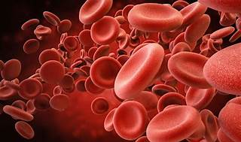
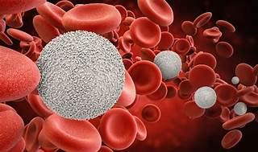
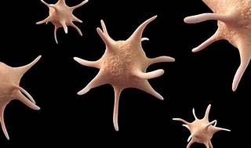
Blood Cells :
Red blood cells transport oxygen from the lungs to the body’s tissues [4].
Red blood cells collect this carbon dioxide and transport it back to the lungs for exhalation [4].
These cells are microscopic and have a flat, disk-like shape.
As part of your immune system, WBC circulate in your blood and respond to injury or illness.
White blood cells are colorless . These extremely tiny cells have a round shape with a distinct center membrane (nucleus).
Platelets are tiny blood cells that play a crucial role in preventing and stopping bleeding.
Platelets are anucleated discoid cells with a diameter of 2–3 μm, average life of 10 days [4].
Red Blood Cells
White Blood Cells
Platelets

Slide 7
YOLO (You Only Look Once)
For the object detection in deep learning applications, we can employ the YOLO (You Only Look Once) algorithm.
It refers to a class of algorithms based on artificial neural networks that are optimized to work with unstructured data such as images, voice, videos, and text.
It provides accurate results and we can easily train and test the model and it also provide various matrix like confusion matrix defaultly.
We use Yolov8 version in this project and it accepts the data in .yaml form.
Yolov8 has defaultly detect the 80 different objects.

Slide 8
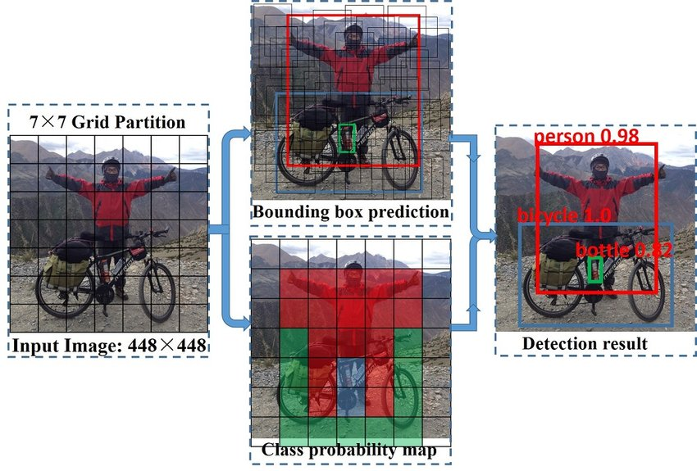
How yolo works?
Divides the input image into an S x S grid
Each grid cell:
Predicts B bounding boxes
Each box has: (x, y, w, h, confidence)
Predicts C class probabilities
Final predictions = Class × Confidence × Bounding Box
Backbone: CNN (e.g., Darknet, CSPDarknet, etc.)
Head: Predicts bounding boxes and classes

Slide 9
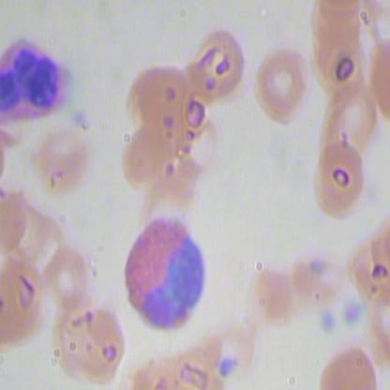
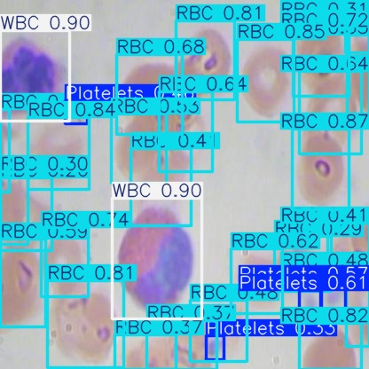
How we use YOLO?
To count blood cells using the YOLO model, collect and annotate a large dataset of blood cell images, marking the locations and types of rbc, wbc, and platelets.
We replace the our dataset and train the model for detection of 3 classes (i.e, WBC,RBC,platelets).
We export the model into different model easily for the future use.
Microscopic blood image
Before detection by
YOLO model
Microscopic blood image
after detection by
YOLO model

Slide 10
Dataset
For this project we found the dataset from the following link: https://public.roboflow.com/object-detection/bccd/4
The dataset contain 416x416 size of microscopic blood images upto 874 images.
Dataset is divided into 765 images for train, 73 for valid and 36 for test.
For each image in train and valid, we have annotation text file containing bounding box info and respective class (i.e, WBC, RBC, Platelets) in yaml format.
In yaml the data in the form key-value pairs.

Slide 11
Drive
YOLO(Folder Name)
Valid
My Drive
Test
Train
README.dataset.txt
README.roboflow.txt
data.yaml
images
labels
images
labels
labels.cache
images
labels
labels.cache
runs
detect
train
Weights
best.pt
Last.pt
After training of dataset, YOLO model creates above file structure.
When dataset is downloaded, the file structure is like this.

Slide 12
Python Implementation
https://github.com/12345aswini/aswini/blob/main/mini.ipynb
The code mounts Google Drive to access the training data and installs the ultralytics package for using YOLOv8 to detect blood cells. It trains a YOLOv8 model on a dataset specified in data.
.yaml for 30 epochs and utilizes the trained model to predict blood cell counts in test images. Subsequently, it processes the prediction results to extract bounding boxes, masks, keypoints , probabilities, and oriented bounding boxes, and saves the results as an image file.

Slide 13
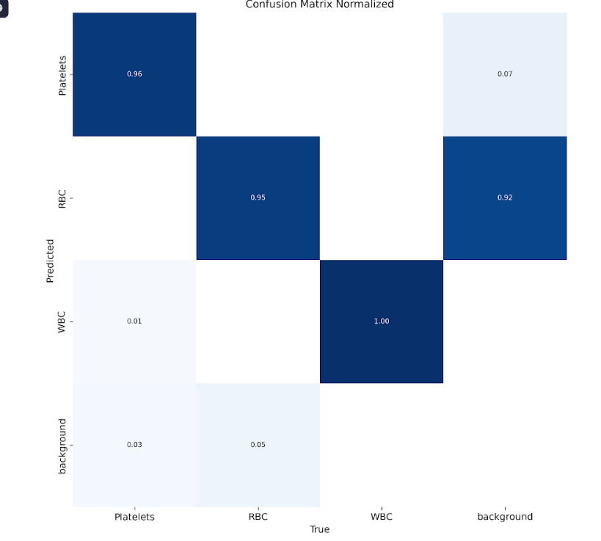
Accuracy of the model
A confusion matrix is a table used to evaluate the performance of a classification model by comparing the predicted labels with the actual labels.
It consists of four key metrics: True Positives (TP), False Positives (FP), True Negatives (TN), and False Negatives (FN).
These metrics help in calculating important performance measures like accuracy, precision, recall, and F1-score.
From the confusion matrix we got accuracy 83% i.e, 2.91/3.51(sum of diagonal values/total values)

Slide 14
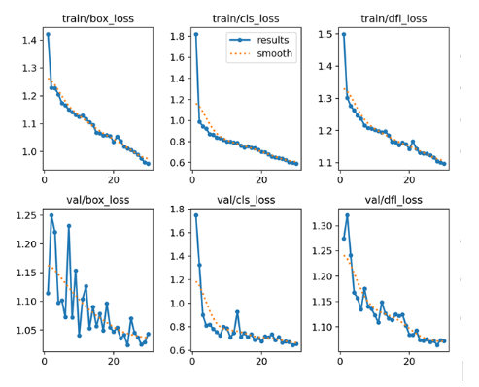
Loss function graph

Slide 15
Steamlit
Streamlit is a Python library designed for creating fast, interactive web apps for machine learning and data science projects with minimal effort.
It provides features like file upload, buttons, image display, and real-time outputs.
In the context of blood cell detection, Streamlit provided an easy-to-use platform where users (doctors, healthcare workers) could interact with the model by simply uploading a blood smear image and getting instant results.

Slide 16
How Streamlit is Used in Our Blood Cell Detection App?
We designed a Streamlit web app that accepts microscopic blood images from the user through a file uploader widget (st.file_uploader)
Uploaded image is displayed using st.image() for confirmation.
Image is sent to the YOLO model for detecting blood cells
Based on detection:
- Highlighted with bounding boxes.
- Final result shown using st.success() or st.error().
Streamlit handles the entire flow in real-time, giving quick and accurate results to the user.

Slide 17
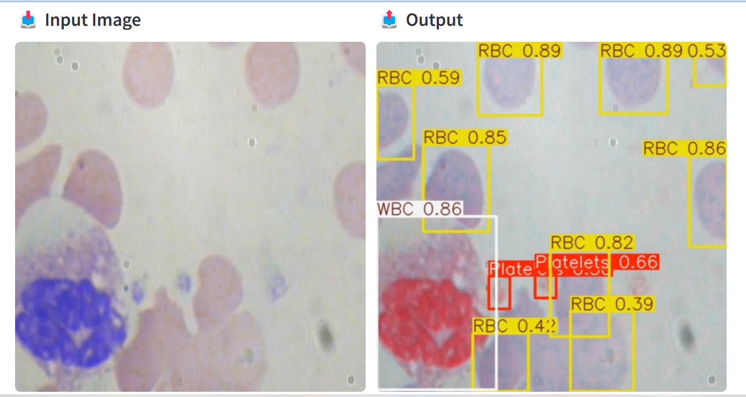
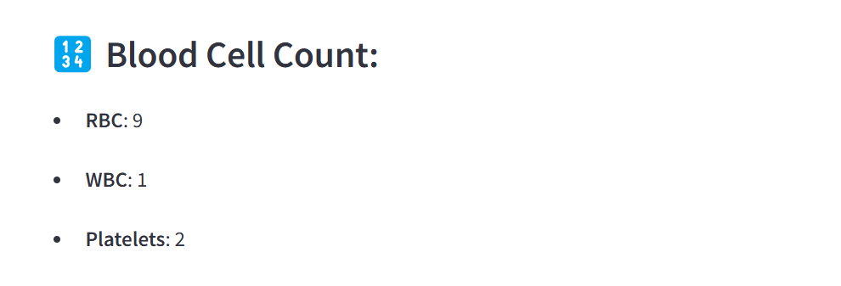
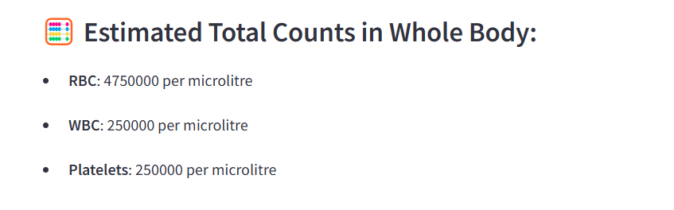
Result:
Output

Slide 18
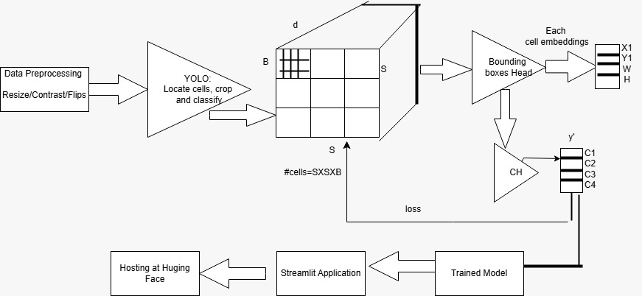

Slide 19
Challenges and Solution
Challenge: Red and white blood cells often overlap or cluster together in blood smears, making it difficult for the YOLO model to distinguish individual cells accurately .
Solution: Incorporate advanced preprocessing steps to separate clustered cells. Train the model on a diverse dataset that includes examples of overlapping cells to improve its ability to handle such scenarios
Limited Training Data Challenge : High-quality, annotated datasets for training the YOLO model are often scarce, limiting its performance and generalizability.
Solution: Generating more datasets using generative models.

Slide 20
Future Scope
By collecting data like each person microscopic blood images upto 5 we can easily average and get complete count of the body through the model.
Deploying this application in an Android app instead of web application will enable easy access to blood cell counts, reducing the cost of CBC (Complete Blood Count) tests, minimizing blood wastage, and enhancing the accuracy and efficiency of BCC (Blood Cell Count) through deep learning.

Slide 21
Conclusion
In conclusion, employing the YOLO model for blood cell counting via deep learning proves to be a highly effective approach, offering accurate and rapid analysis of blood samples.
This method streamlines laboratory processes, reducing manual effort, cost , requirement of Blood and potential errors while enabling real-time analysis for timely medical decision-making.
The integration of YOLO model showcases the potential of deep learning in revolutionizing medical diagnostics, promising improved efficiency and accuracy in blood cell counting tasks.

Slide 22
References
https://public.roboflow.com/object-detection/bccd/4
https://yolov8.com/
https://www.geeksforgeeks.org/introduction-deep-learning/
https://medlineplus.gov/blood.html#
https://kili-technology.com/data-labeling/machine-learning/yolo-algorithm-real-time-object-detection-from-a-to-z

Slide 23
Questions and Answers

Slide 24
Thank you

